Slide 1
Journey Mapping
business Process Engineering
Aaradhy Sharma
RiTi Ganesh gawde

Slide 2
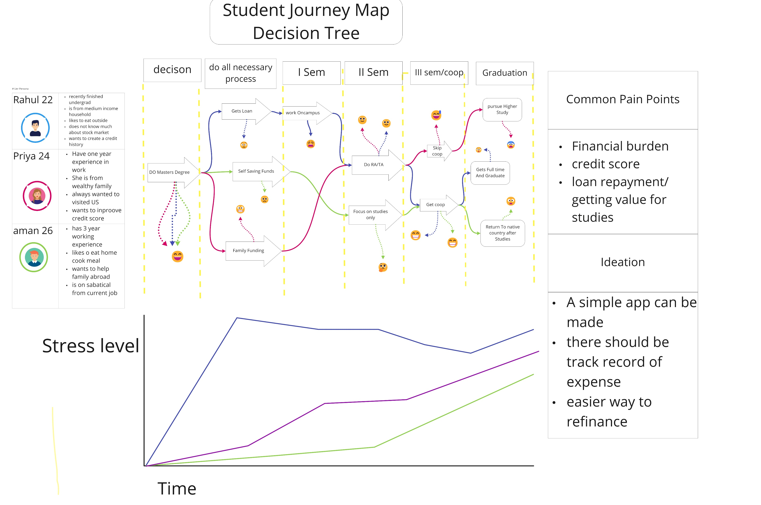

Slide 3
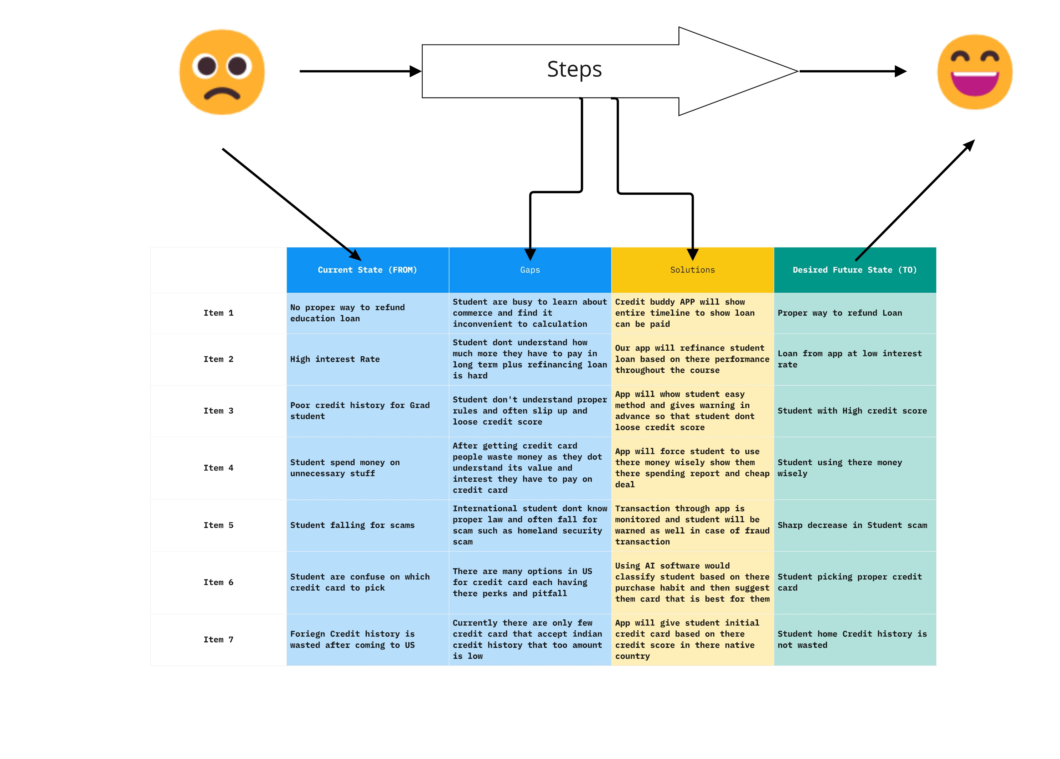
Gap Analysis

Slide 4
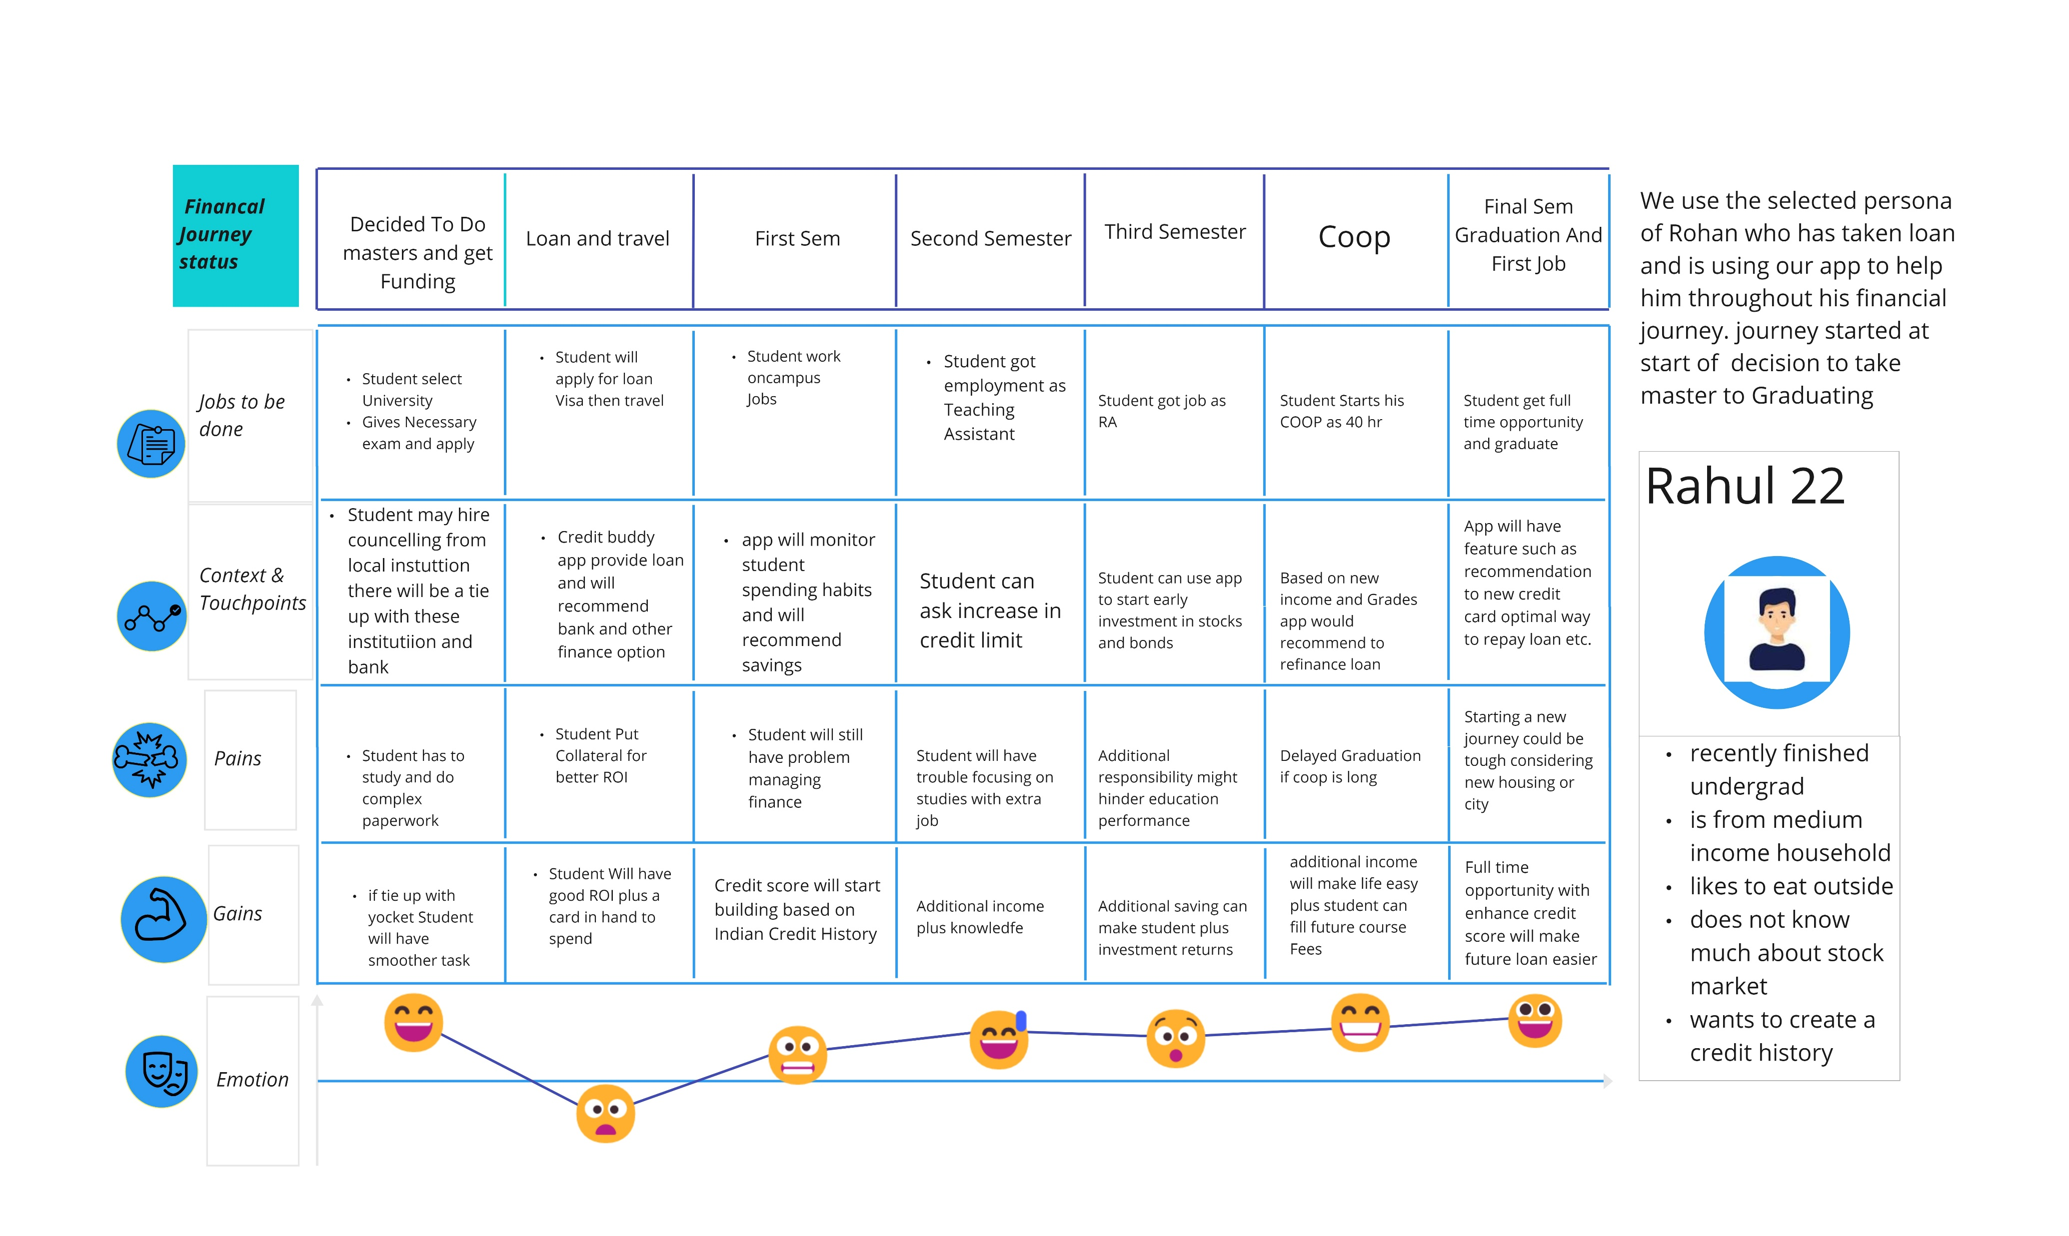
Future Journey Mapping

Slide 5
Thank You

